Slide 1
Level Up
daily, bite-sized tasks and experiences that makes career growth and exploration fun and achievable

Slide 2

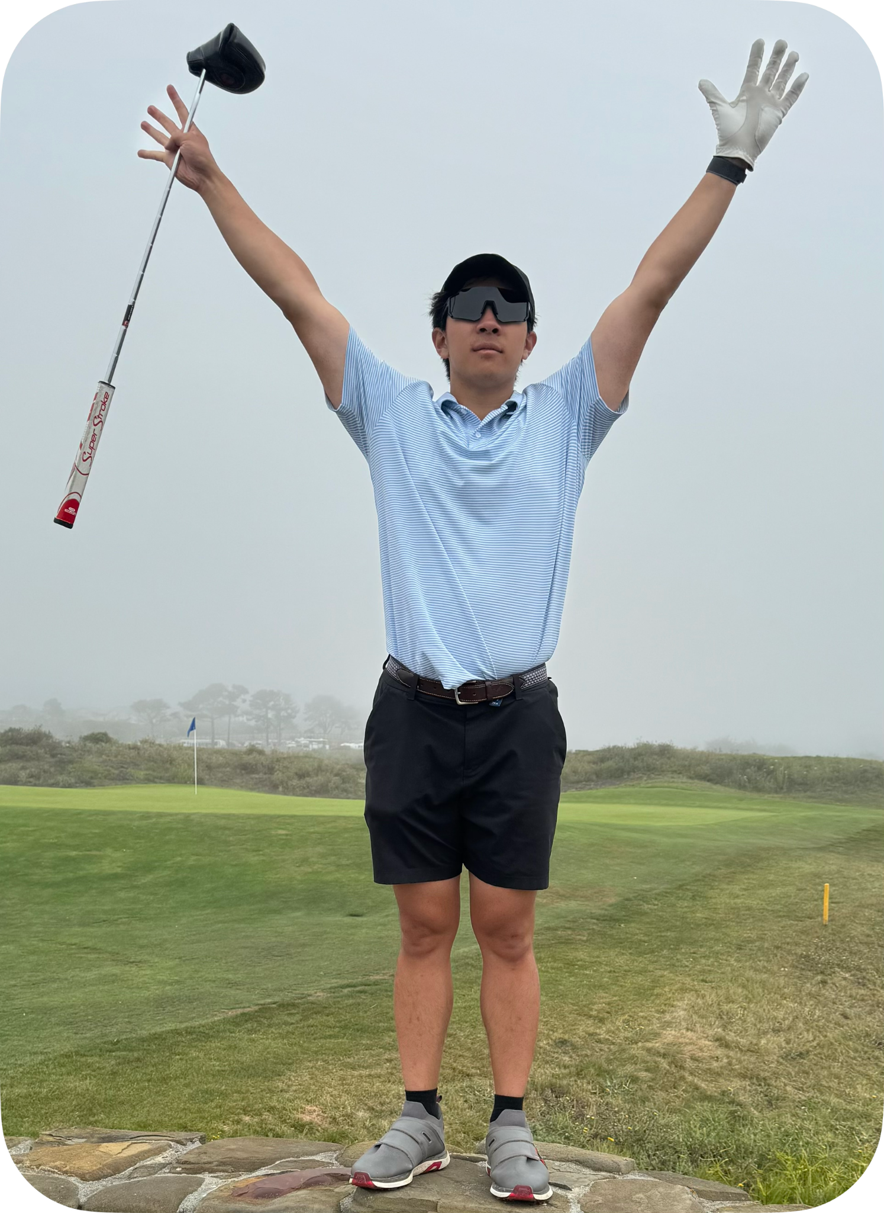
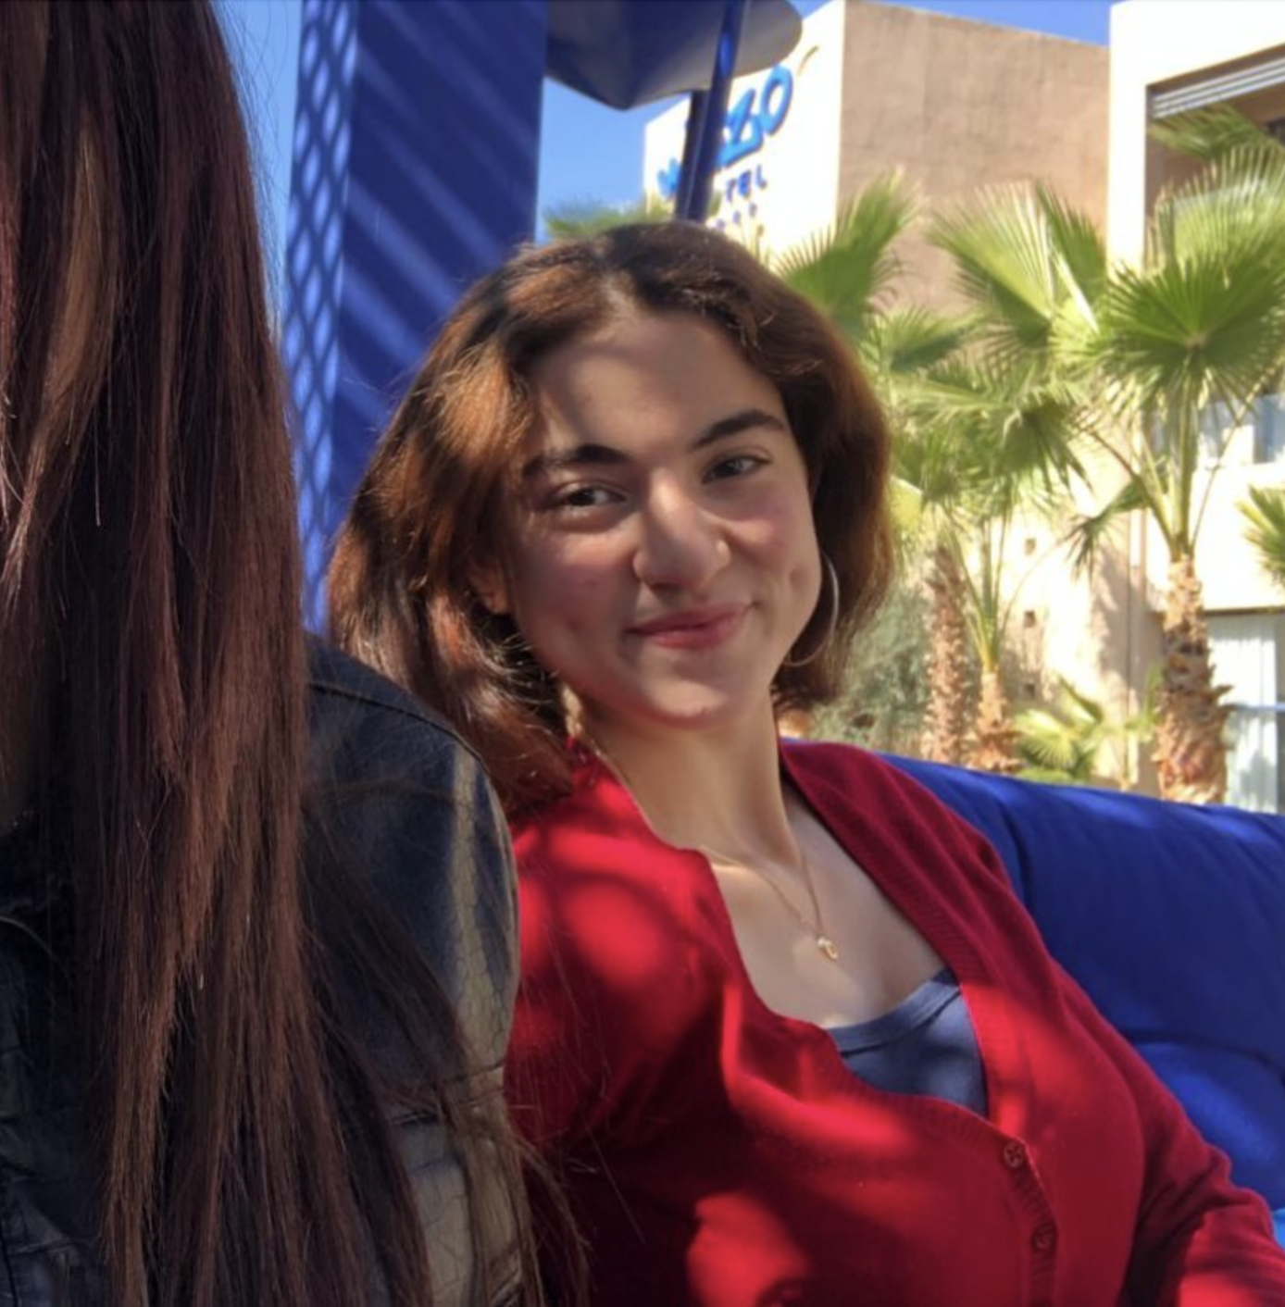

Team
Taralyn
Nick
Maroua
Varsha
Class of 2026
Computer Science,
Human Computer Interaction
Class of 2024 (2025???)
Mechanical Engineering,
Product Realization
Class of 2026
Computer Science,
Human Computer Interaction
Class of 2026
Computer Science,
Human Computer Interaction

Slide 3
Context
POV
HMW
We met Danna, a high achieving high school senior. We were surprised to notice that despite her frustration with the self-destructive, competitive Bay Area culture, she fed into it. We wonder if it means that Danna has an internal fear of going against the status quo. It would be game changing if we can maintain a sense of fulfillment and value in doing something unconventional.
HMW empower young individuals to explore future possibilities without feeling restricted by convention?
Solution
Providing unconventional tasks to drive career growth and development

Slide 4
Refined Problem
➢ Young people feel large amounts of stress surrounding academic and career development
➢ Professional goals can feel large and unachievable
➢ There is a lack of guidance and support surrounding the less technical aspects of career development (ie: soft skills such as networking or creativity)

Slide 5
Refined Solution
“Our solution breaks looming career challenges into bite-sized, novel tasks. Through daily experiences, users steadily “Level Up”, building valuable career-oriented skills and exploring new opportunities they might not have considered, all while tracking their progress over time.”

Slide 6
Why “Level Up”?
➢ Progress
Suggests a sense of measurable progress
Users are advancing their skills in small, meaningful ways
➢ Gamification
Goal of app is to make career development easier and more fun!
➢ Opportunities
Users will have access to new, improved opportunities
Users are trying things they wouldn’t otherwise do

Slide 7
Value Proposition
☑
✈︎
Bite-Sized Tasks
New Experiences
✎
☆
Track Progress
Achieve Goals
Break career-development into achievable daily tasks
Feature novel and out-of-the-box activities
Add a degree of motivation and engagement to skill-development
Ultimately acquire skills and reach career goals

Slide 8
Market Research

Slide 9
Masterclass
MasterClass is a web-based learning platform offering video-based courses taught by experts across various fields.
What worked for them?
What didn’t work for them?
➢ High-Quality Content: Engaging and well-produced modules make learning fun and immersive.
Story-Driven Approach: Courses go beyond basic skills, integrating personal experiences and stories.
➢ Lack of Depth: Some modules focus more on storytelling and entertainment, sometimes lacking comprehensive knowledge.
Limitations in Interaction: Pre-recorded lessons limit real-time engagement and hands-on practice.

Slide 10
Masterclass
MasterClass is a web-based learning platform offering video-based courses taught by experts across various fields.
What sets our solution apart?
Implications for our Solution
➢ Hands-on learning tasks and progress tracking, promoting deeper learning and community sharing, which MasterClass lacks.
➢ We should focus on developing depth in skills and ensuring both breadth and depth in content, especially in soft skills.

Slide 11
Goosechase
A gamified scavenger hunt app blending real-world challenges with virtual experiences.
What worked for them?
What didn’t work for them?
➢ Gamification for Engagement: Allows high engagement through elements such as earning points and competing on leaderboards.
➢ Customization: Added personalization as users can create their unique, tailored scav hunts.
➢ Niche Appeal: Focus on scavenger hunts can limit app’s appeal to broader audiences who are looking for long-term engagement.
Limitations in App Interaction: While the app promotes real-world activities, it doesn’t provide much ongoing interaction within the app itself to keep users engaged.

Slide 12
Goosechase
A gamified scavenger hunt app blending real-world challenges with virtual experiences.
What sets our solution apart?
Implications for our Solution
➢ Level Up offers career-focused, actionable tasks with clear goals in mind that provide measurable outcomes. This ensures that users can see tangible progress and self-improvement, unlike Goosechase’s more casual focus.
➢ We should ensure that while promoting real-world engagement, users remain engaged with the app throughout their entire journey. Further, it's important to offer a diverse range of skills and tasks to avoid limiting the app to a very niche audience.

Slide 13
Habitica
Habitica is a task manager that gamifies habit-building, with users earning rewards for completing real-world tasks.
What worked for them?
What didn’t work for them?
➢ Gamification for Engagement: Provides gamified extrinsic motivators for non intrinsically motivated tasks.
➢ Communal Accountability: Promotes group quests and keeping each other accountable, creating a supportive network for habit building.
➢ Complexity for Casual Users: While the gamification can draw in some users, those who have simple ways of going about completing tasks can be overwhelmed with overly complex systems, thereby deterring them away.

Slide 14
Habitica
Habitica is a task manager that gamifies habit-building, with users earning rewards for completing real-world tasks.
What sets our solution apart?
Implications for our Solution
➢ Our solution has a simple and goal oriented approach: users will not complete complicated immersive tasks but instead carry out real life tasks and watch their skills level up over time.
➢ Creating collaborative tasks or team challenges, similar to Habitica’s quests, could help Level Up build a stronger sense of community around career exploration.

Slide 15
Khan Academy
Khan Academy is an educational platform offering video tutorials and exercises in academic subjects, with self-paced learning.
What worked for them?
What didn’t work for them?
➢ Tailored Learning: Khan Academy’s progress tracking and tailored exercises ensure learners are consistently challenged and continue to grow.
Mastery-Based Learning: Emphasizes learning concepts deeply before proceeding, allowing users to master topics.
➢ Limited Interactivity: Khan Academy lacks real-time, hands-on interactivity, reducing engagement for learners who prefer more dynamic learning environments.
Narrow Focus on Academics: Highly focused on academic subjects, leaving gaps in skill-building in areas like soft skills or career exploration.

Slide 16
Khan Academy
Khan Academy is an educational platform offering video tutorials and exercises in academic subjects, with self-paced learning.
What sets our solution apart?
Implications for our Solution
➢ Level Up offers a broader range of task types, focusing on both soft and technical skills needed for career growth, not just academic knowledge.
➢ We should look into the creation of personalized tasks based on users' progress, ensuring tailored skill development.
➢ Encouraging users to master certain skills (have multi-levels) before progressing could create more meaningful growth in their career exploration journey.

Slide 17
Tasks
Simple
Moderate
Complex
Develop communication skills
Get better at technical interviews
Improve resume
Track personal progress over time
Reflect on tasks and progress
Create a roadmap for achieving goals
Compare progress with other people
Gain certification or universal proof of skill development

Slide 18
Tasks
Simple
Moderate
Complex
Develop communication skills
Get better at technical interviews
Improve resume
Track personal progress over time
Reflect on tasks and progress
Create a roadmap for achieving goals
Compare progress with other people
Gain certification or universal proof of skill development

Slide 19
Storyline
Nick, a novice Level 1 professional, starts out by failing an interview. He realizes he needs to take action and work on his communication skills. Luckily, he is presented with an outline of various tasks he can do to improve this skill. We follow Nick as he networks with strangers, applies to jobs on LinkedIn, and works on a project with a team; all while “Leveling Up” and tracking his skill development over time. The video ends with Nick, now Leveled Up to Level 100, in line for another interview. While in line, he greets his colleagues and they compare their progress with each other. The video ends with Nick doing well at the final interview, thanks to his Leveled Up communication skills!

Slide 20
Storyboards

Slide 21
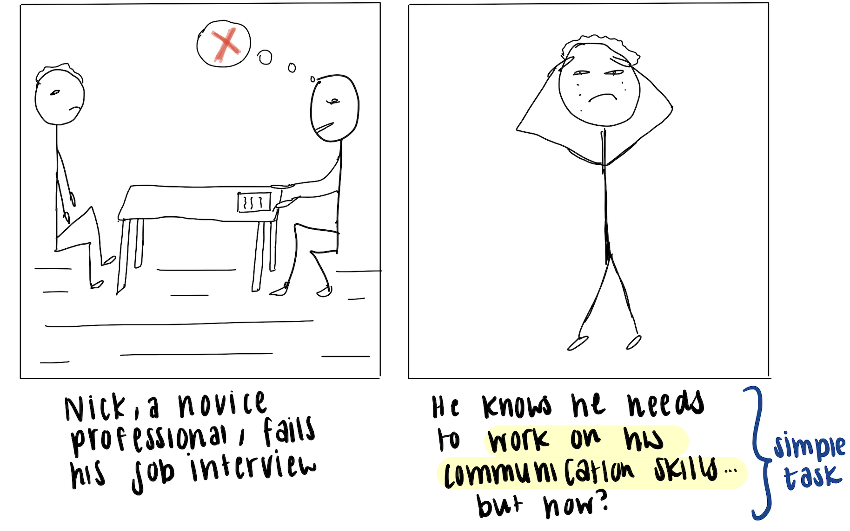

Slide 22
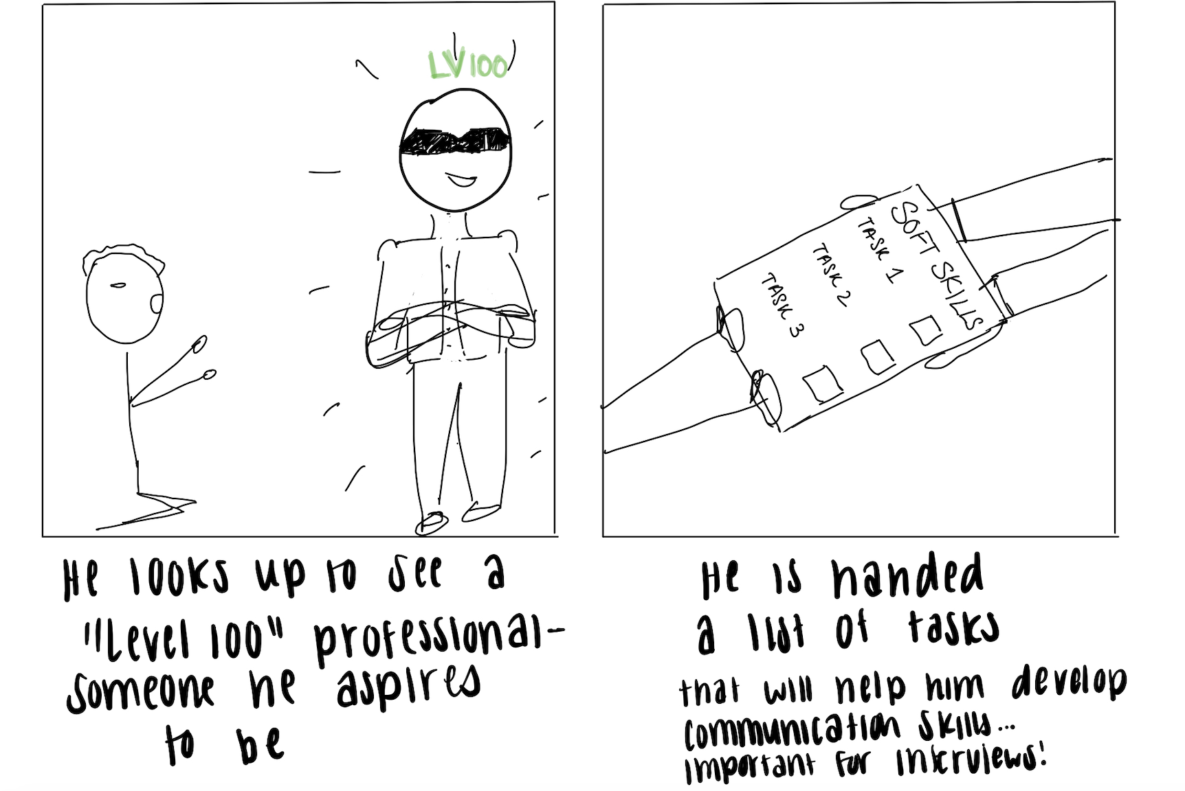

Slide 23
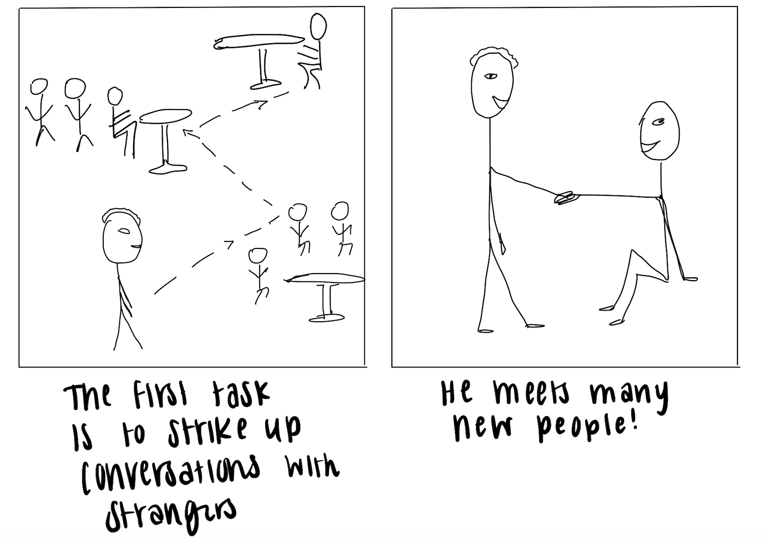

Slide 24
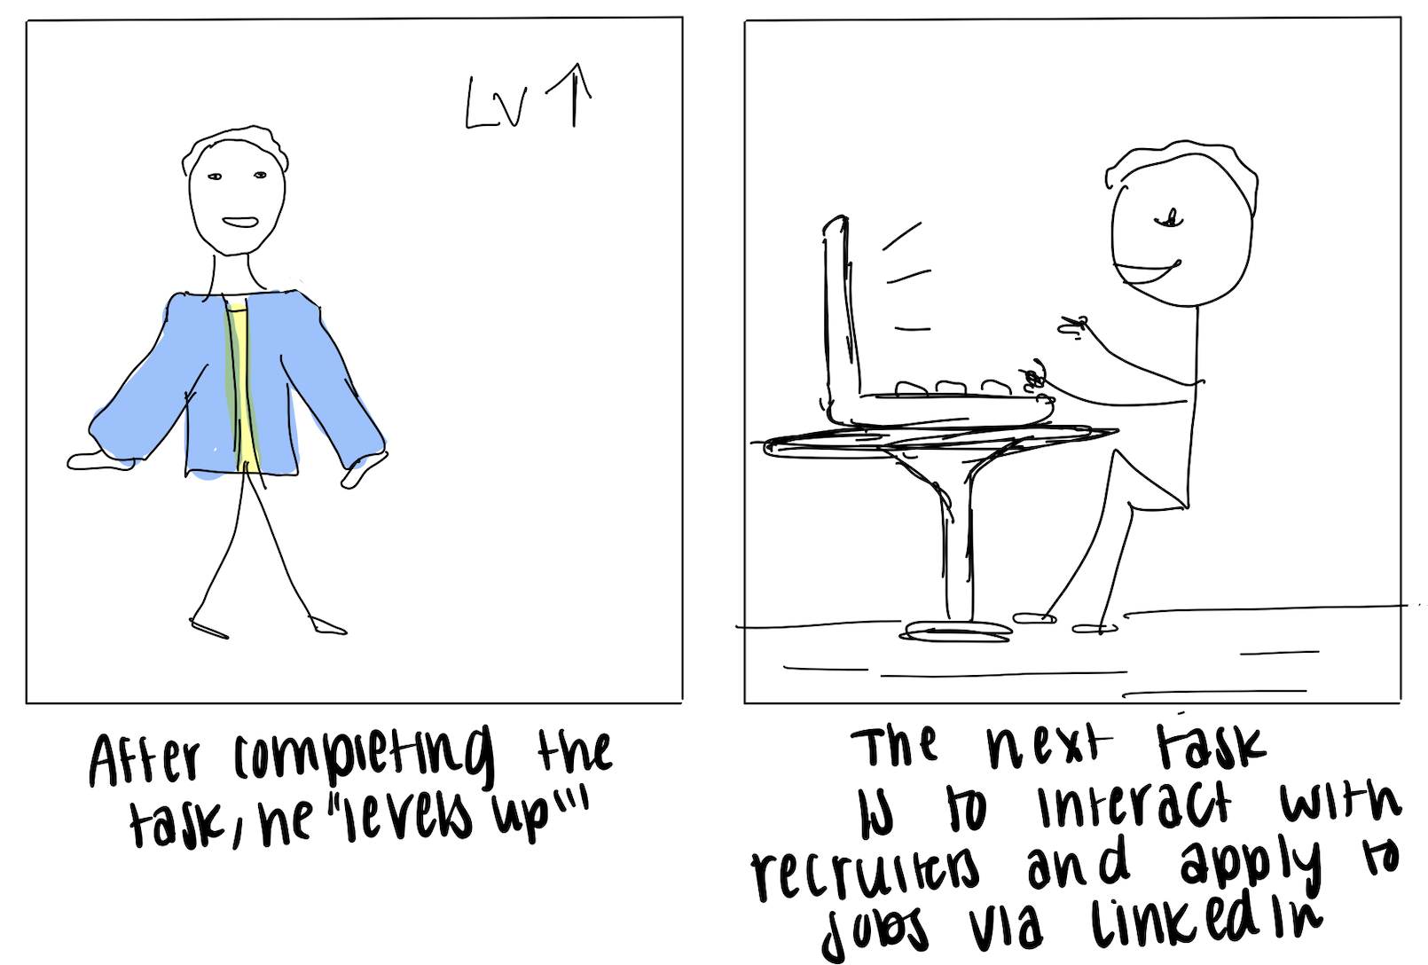

Slide 25
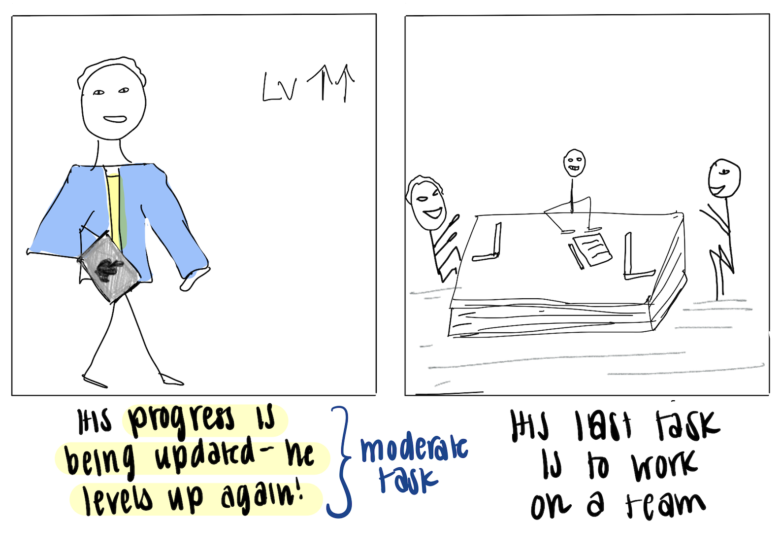

Slide 26
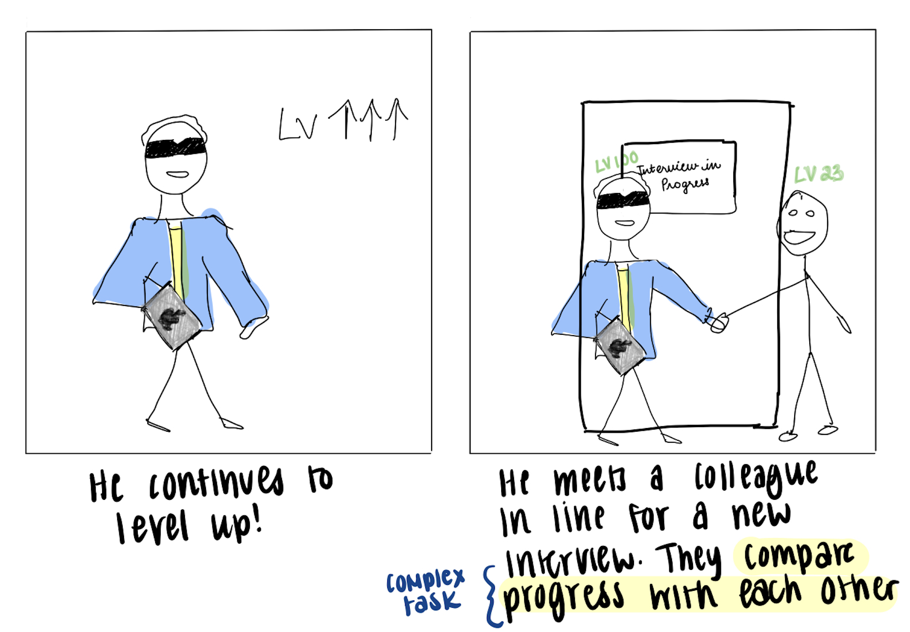

Slide 27
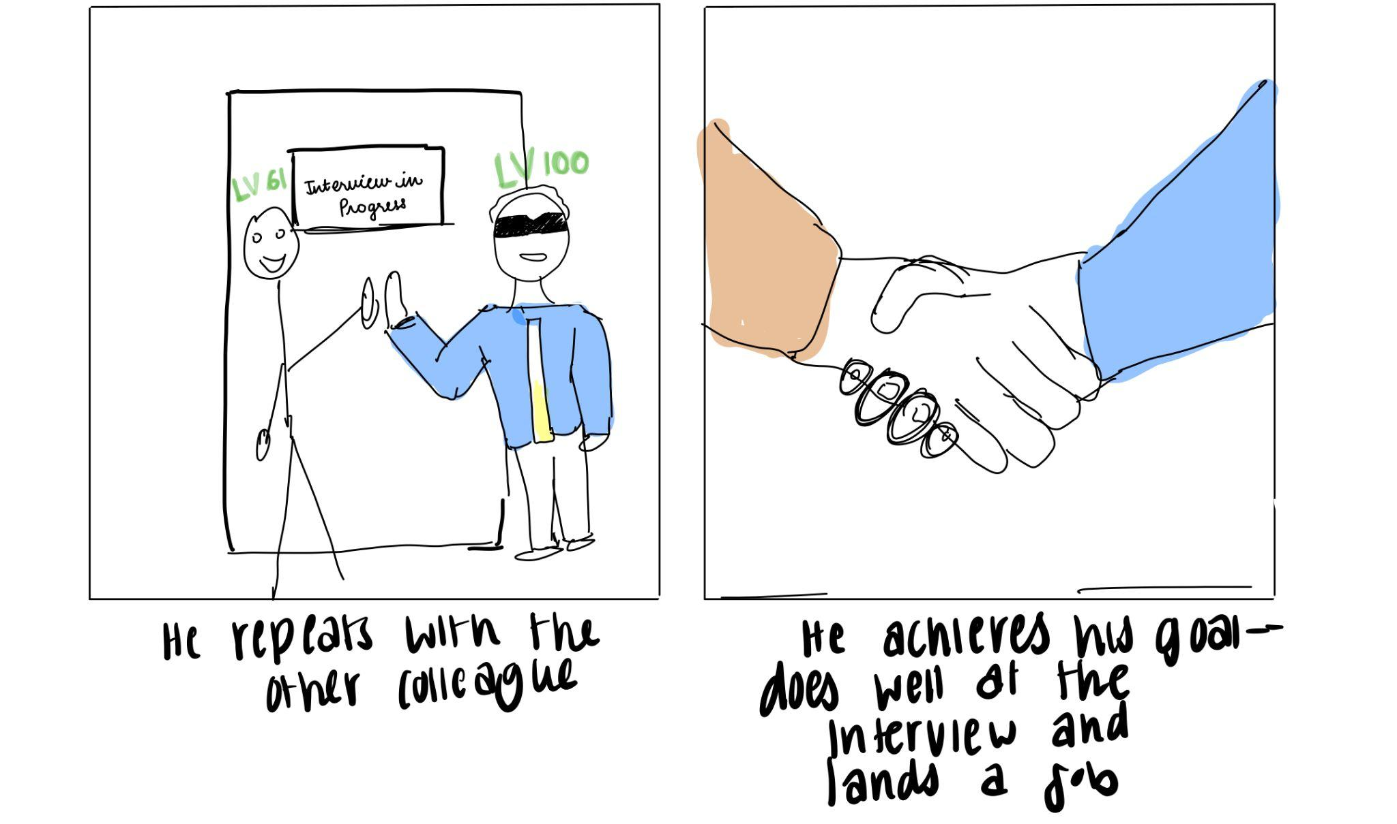

Slide 28
Values and Ethical Implications

Slide 29
Design Values
Privacy
Accessibility
We commit to getting user consent before using their data and sharing their progress with contacts.
01
02
We commit to only assigning tasks that are achievable by every user regardless of disability status.
Positivity
Sustainability & Society
We commit to approaching every user with optimism and positivity regardless of their progress, opting for optimistic encouragement to accomplish tasks.
03
04
We commit to providing training to earn skills useful to entering the workforce.

Slide 30
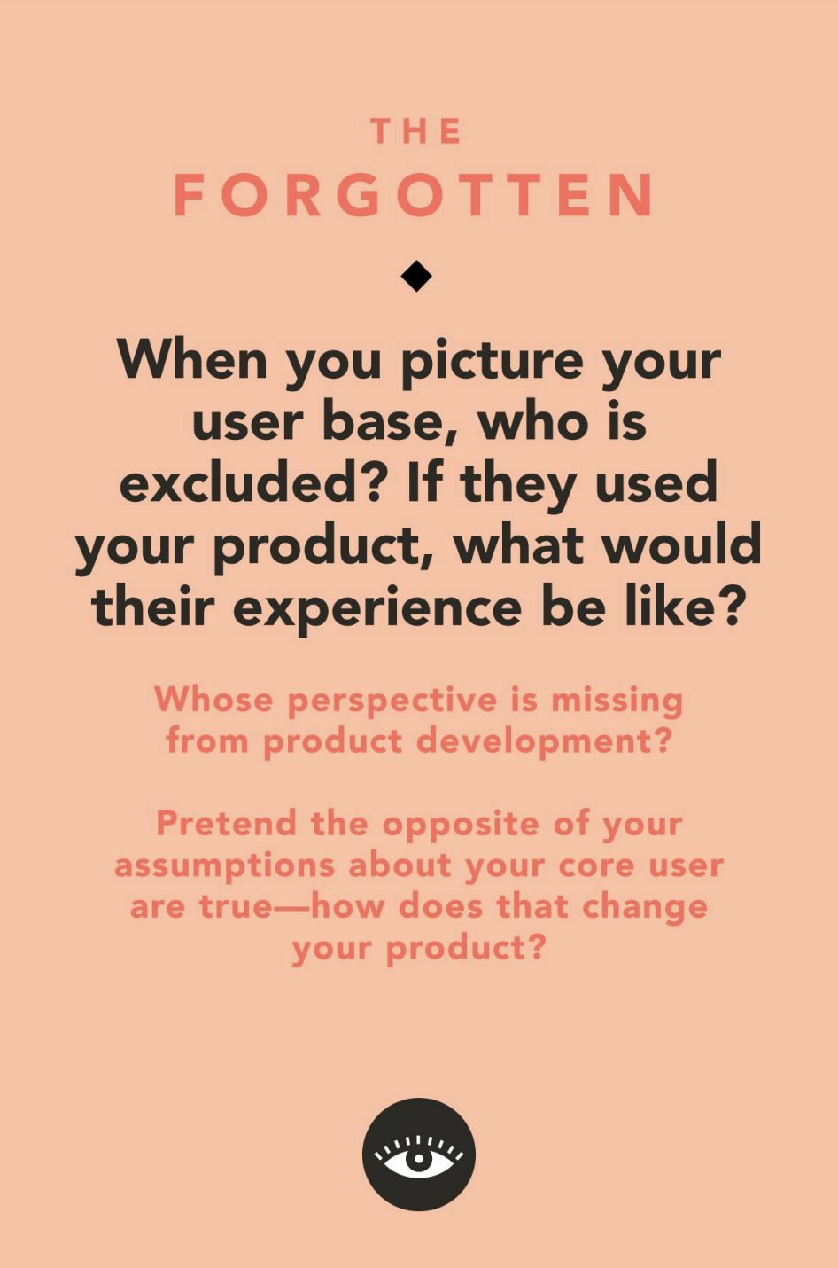
The Tarot Card of Tech: the forgotten
Who’s excluded from the service?
Individuals who lack the time to invest in reaching the desired skill level.
Who’s excluded from the development?
We primarily worked with professionals or students aiming to advance academically or professionally, unintentionally excluding those focused on learning skills for non professional purposes.
How would their experience look like?
Individuals looking for instant results may feel frustrated by slower progress. Those interested in social skill-building may feel the profession-oriented tasks are irrelevant and a waste of time.
How would our product change if we reversed our assumptions?
We would offer faster-paced modules for quicker results and introduce more social skill focused content to appeal to users seeking instant and practical outcomes.

Slide 31
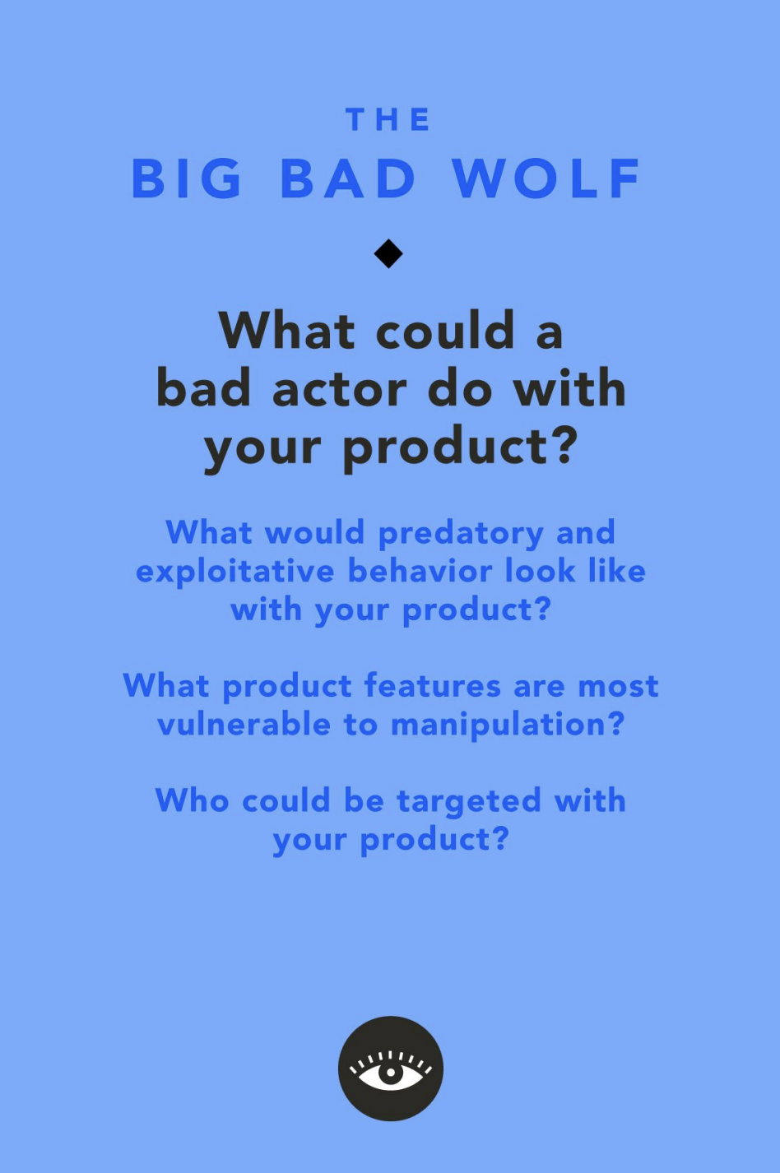
The Tarot Card of Tech: the big bad wolf
What could a bad actor do with your product?
A bad actor might tamper with the tasks, creating tasks that might endanger or discomfort users. Similarly, user data could be misused, emphasizing need for clear consent and data protection
What would predatory and exploitative behavior look like with your product?
Some individuals may introduce cut throat, toxic behaviors into the environment, causing stress for others.
What product feature is most vulnerable to manipulation?
The completion and submission of tasks can be manipulated as users can falsely claim progress or mastery of skills without actually completing task
Who could be targeted with your product?
Recent graduates or students, with little exposure to the professional world can be vulnerable to exploitation, as they may be pressured into achieving fast results in a competitive environment.

Slide 32
Concept Video
https://youtu.be/6alqjBD_CSU

